Slide 3
What is data?
teminology

Slide 4
Visualize
Regression, clustering, Qlearning

Slide 5
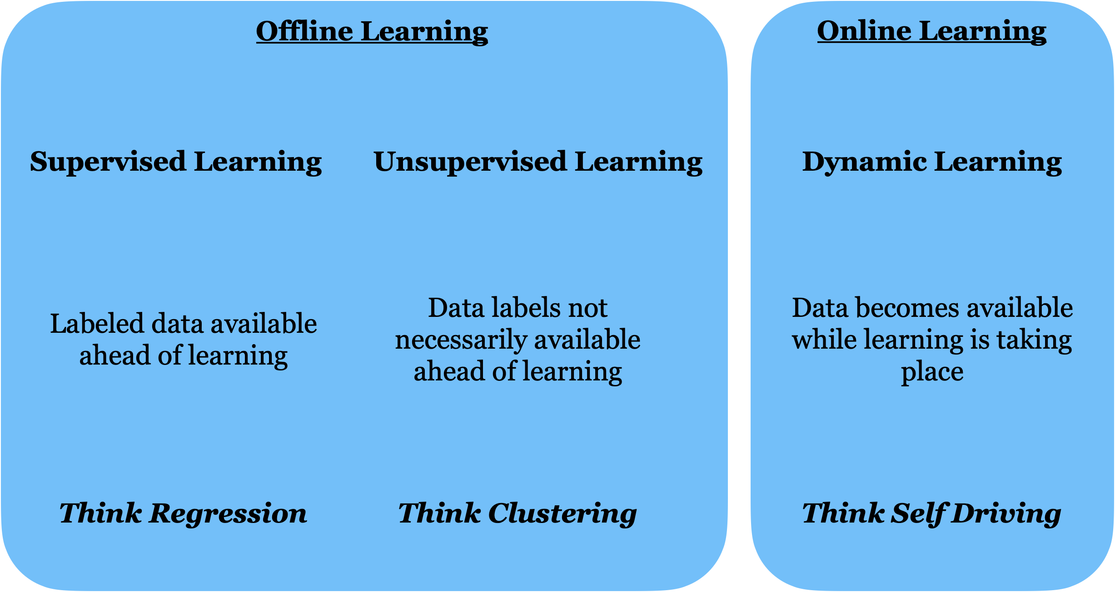

Slide 6
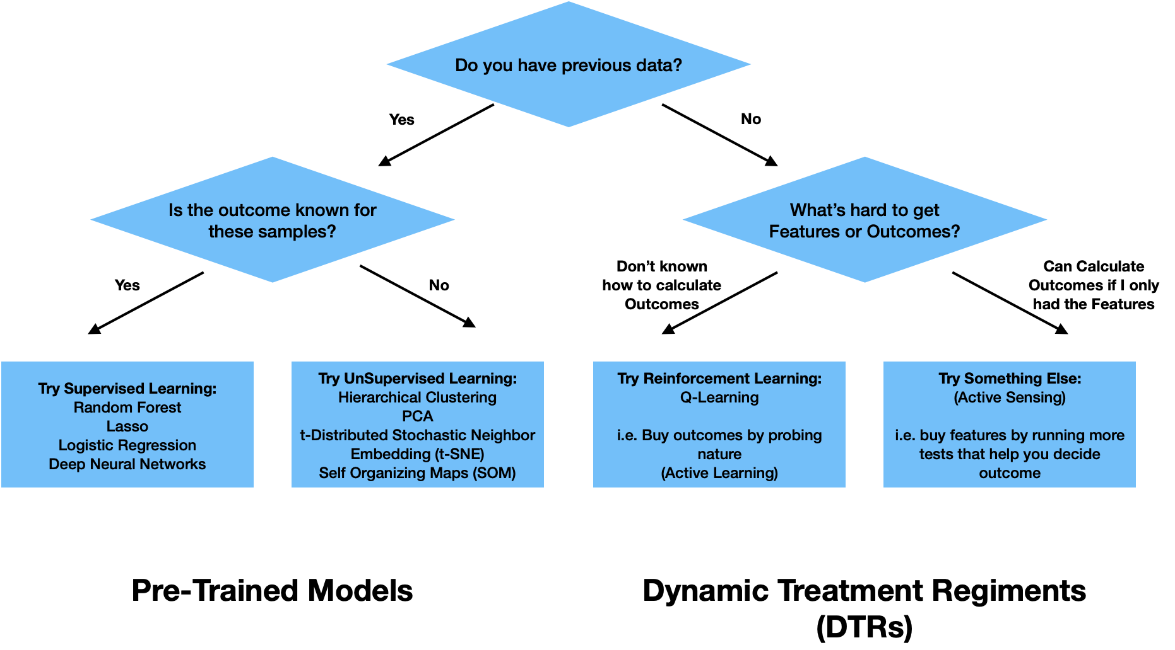

Slide 7


Slide 8
One layer deep = linear regression
Visualize one layer deep model (use this fig when teaching regression)

Slide 9
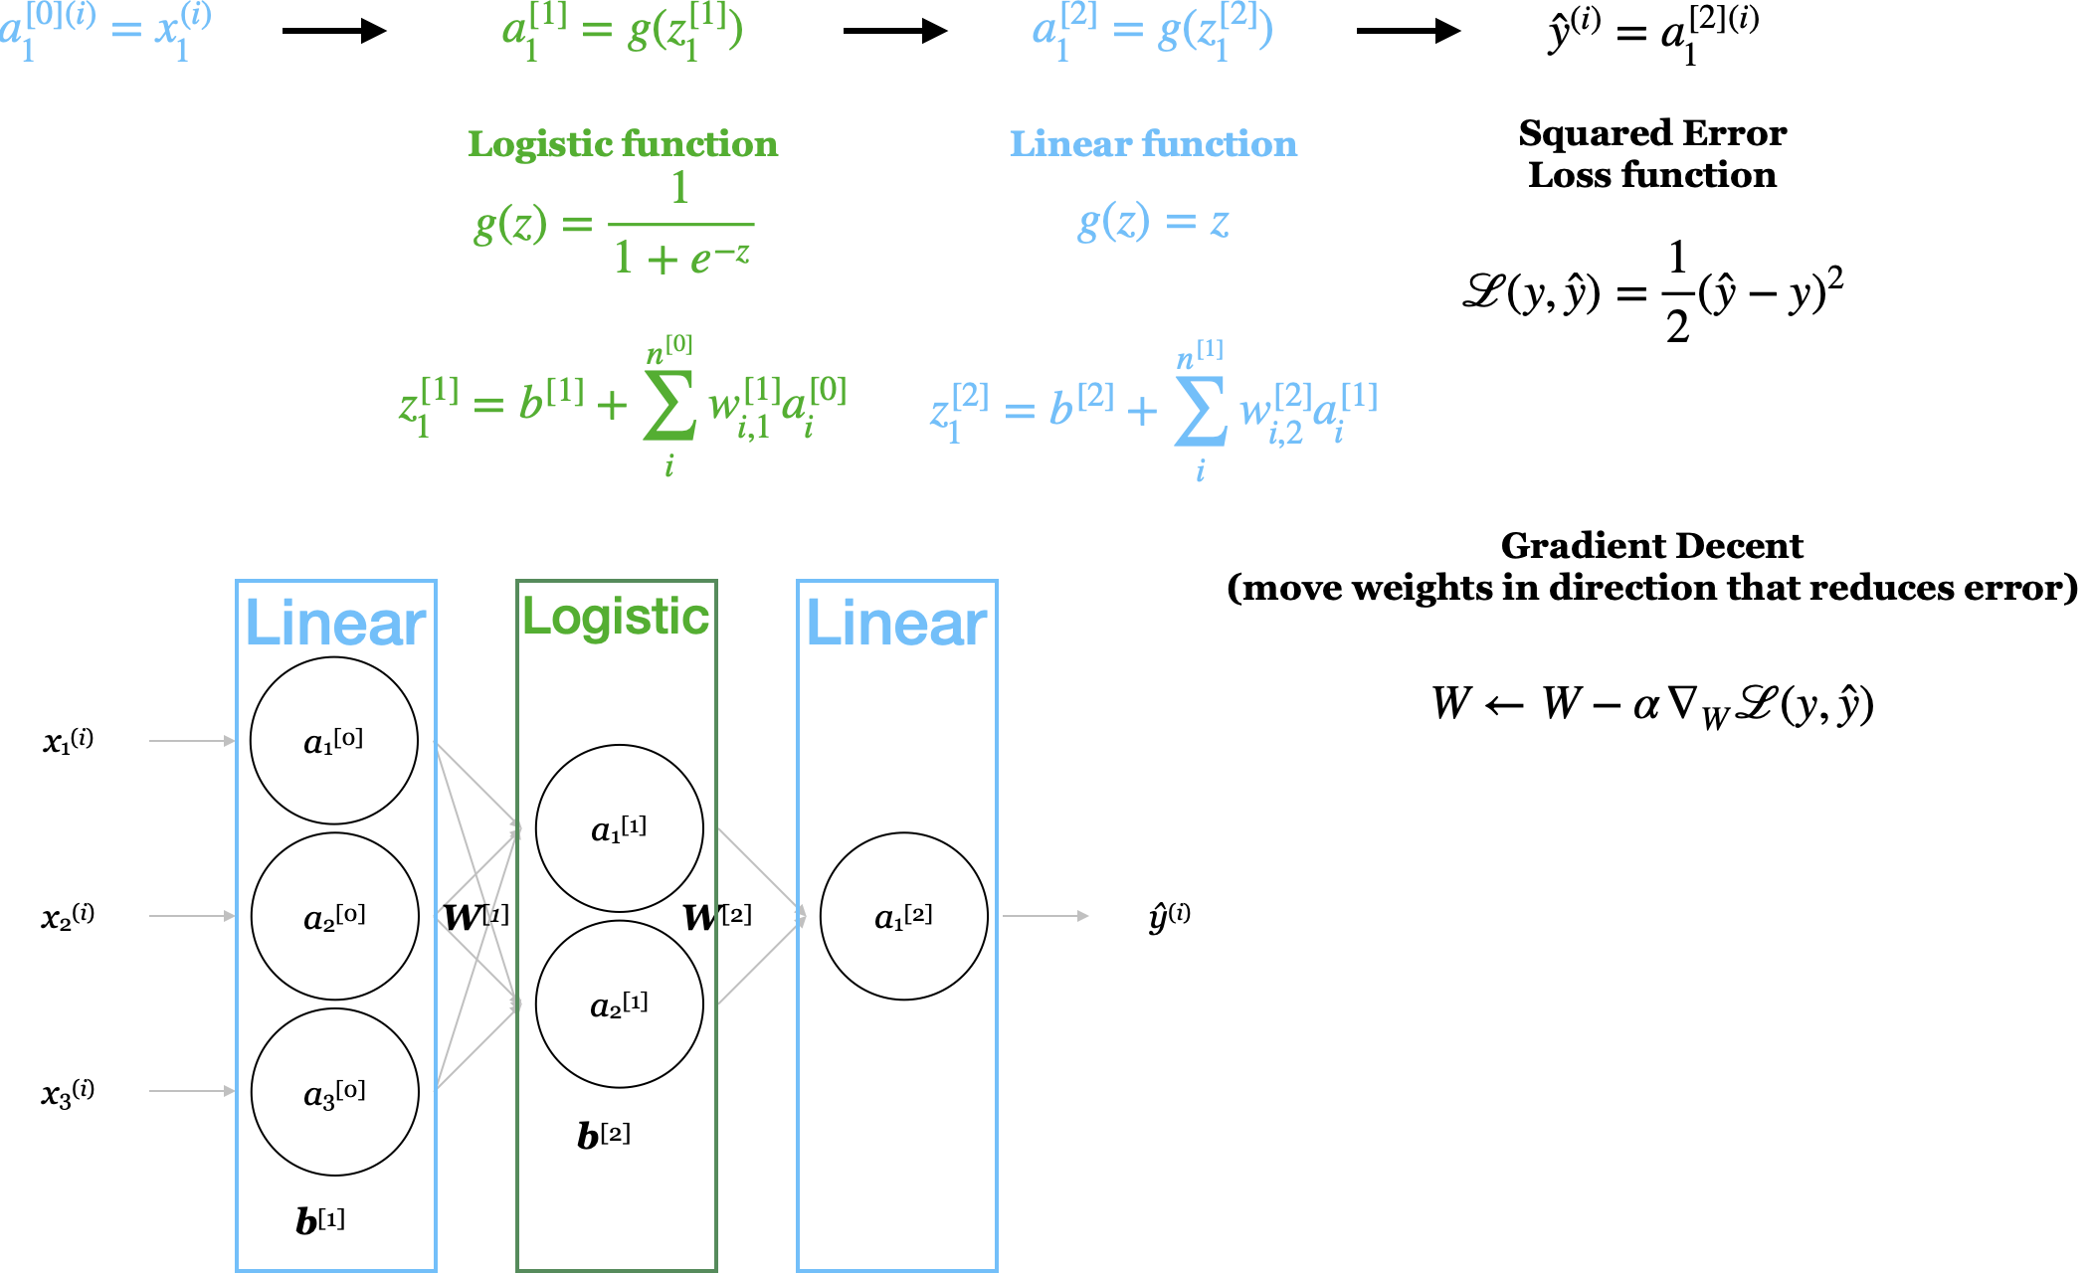
Notes:
Big sigma scary –figure for gratident decent

Slide 10
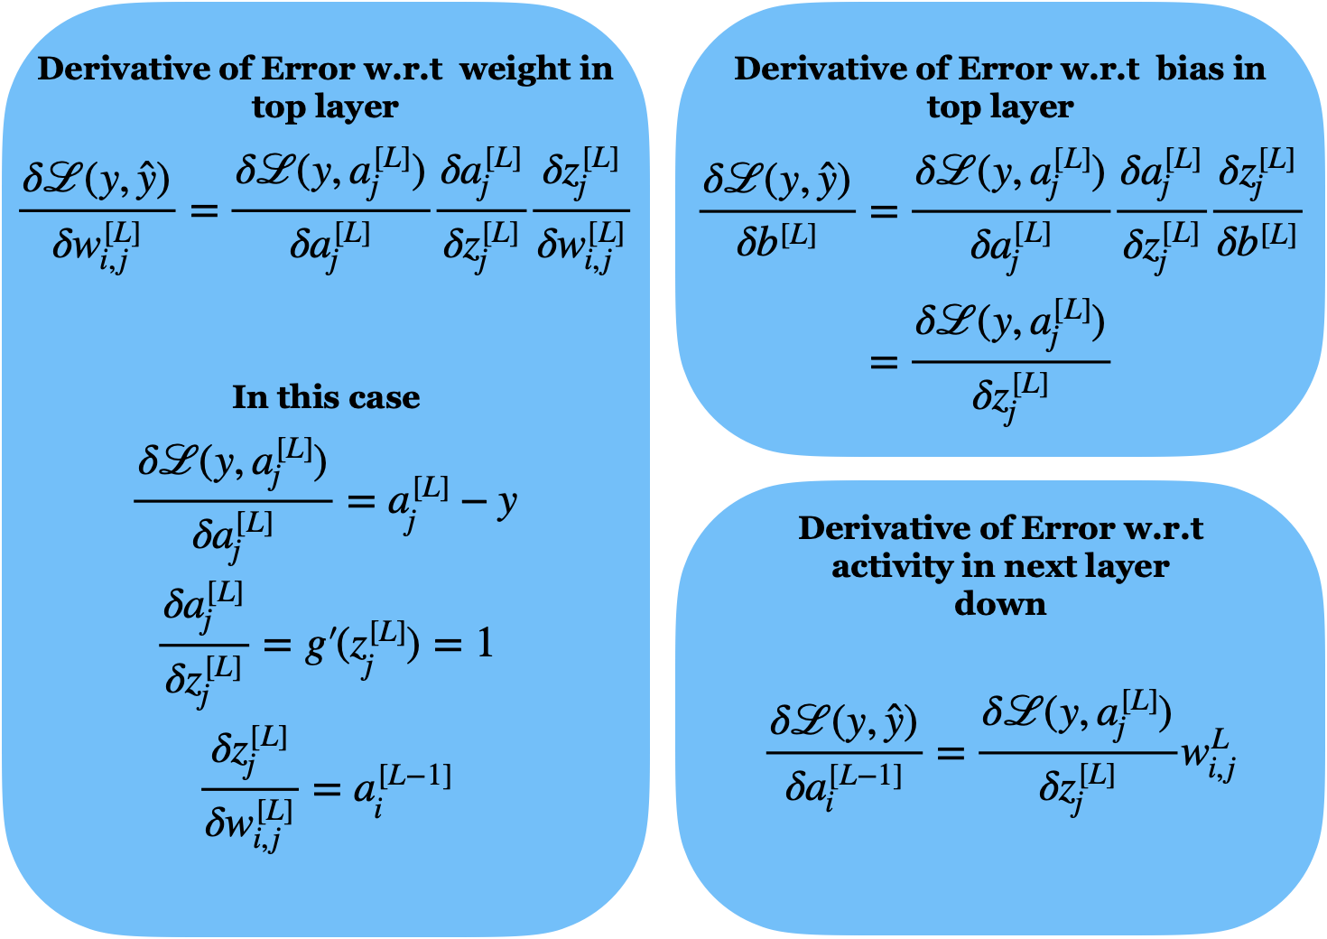

Slide 11
Cool examples

Slide 12
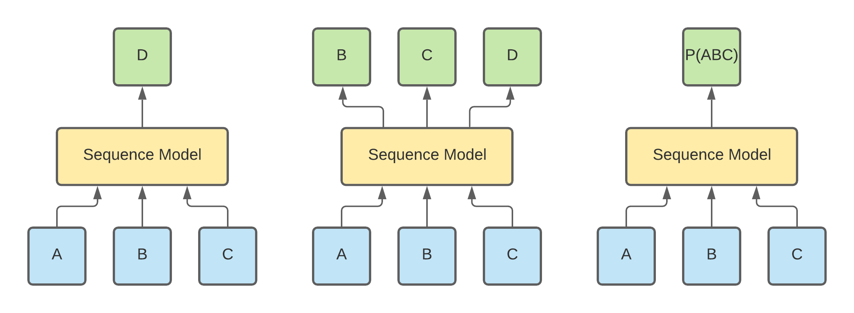
Notes:
GP3 – NPL examples

Slide 13
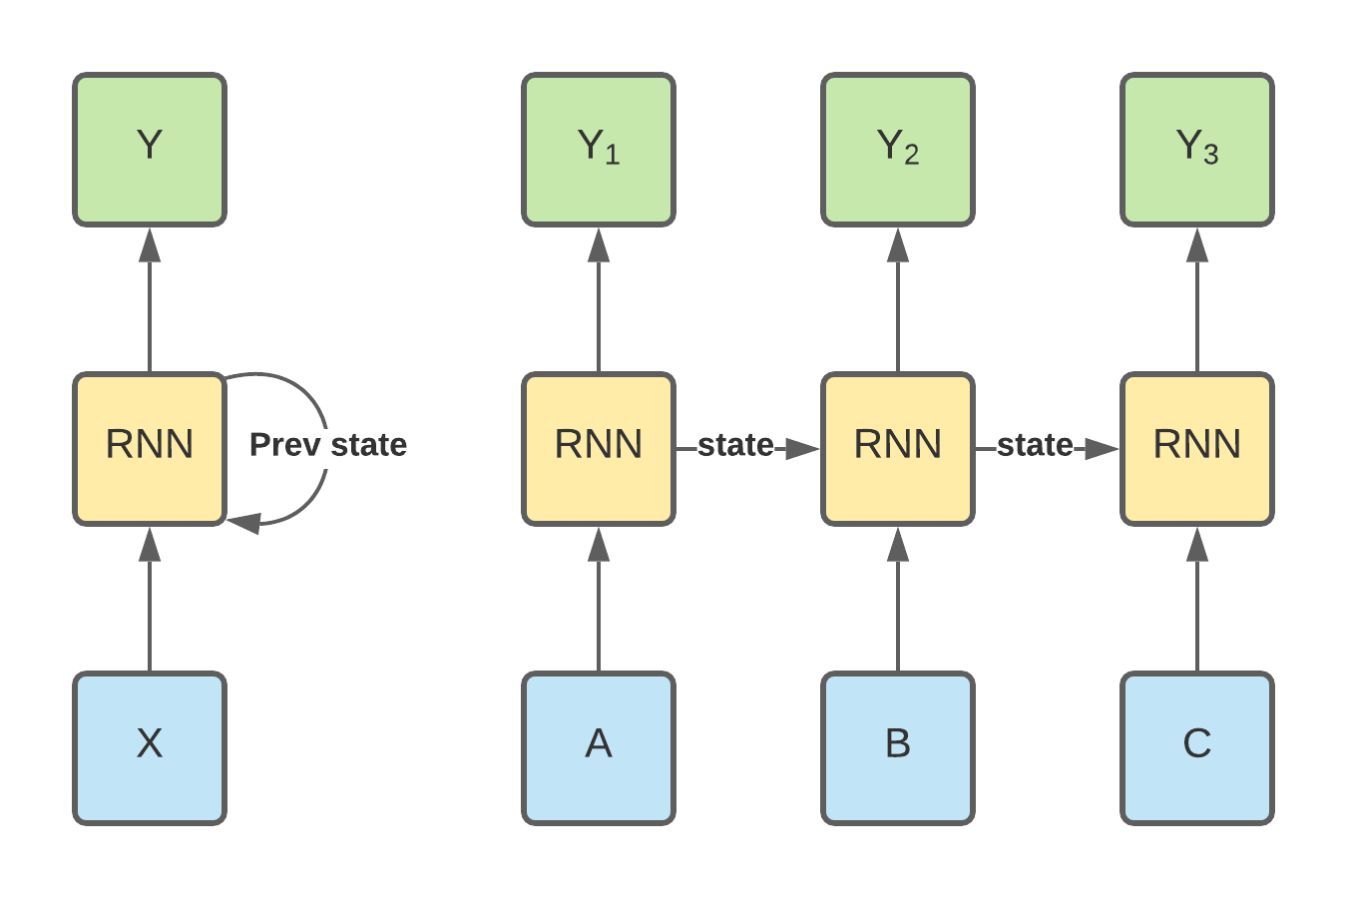

Slide 14
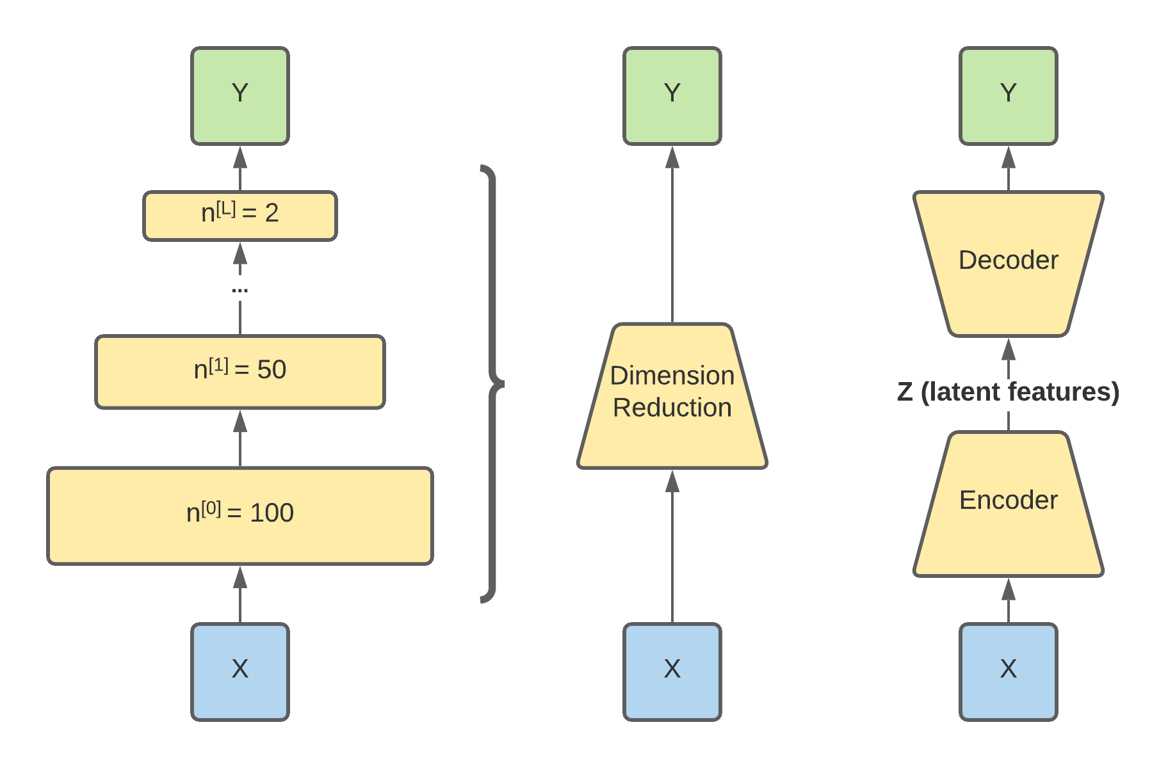

Slide 15
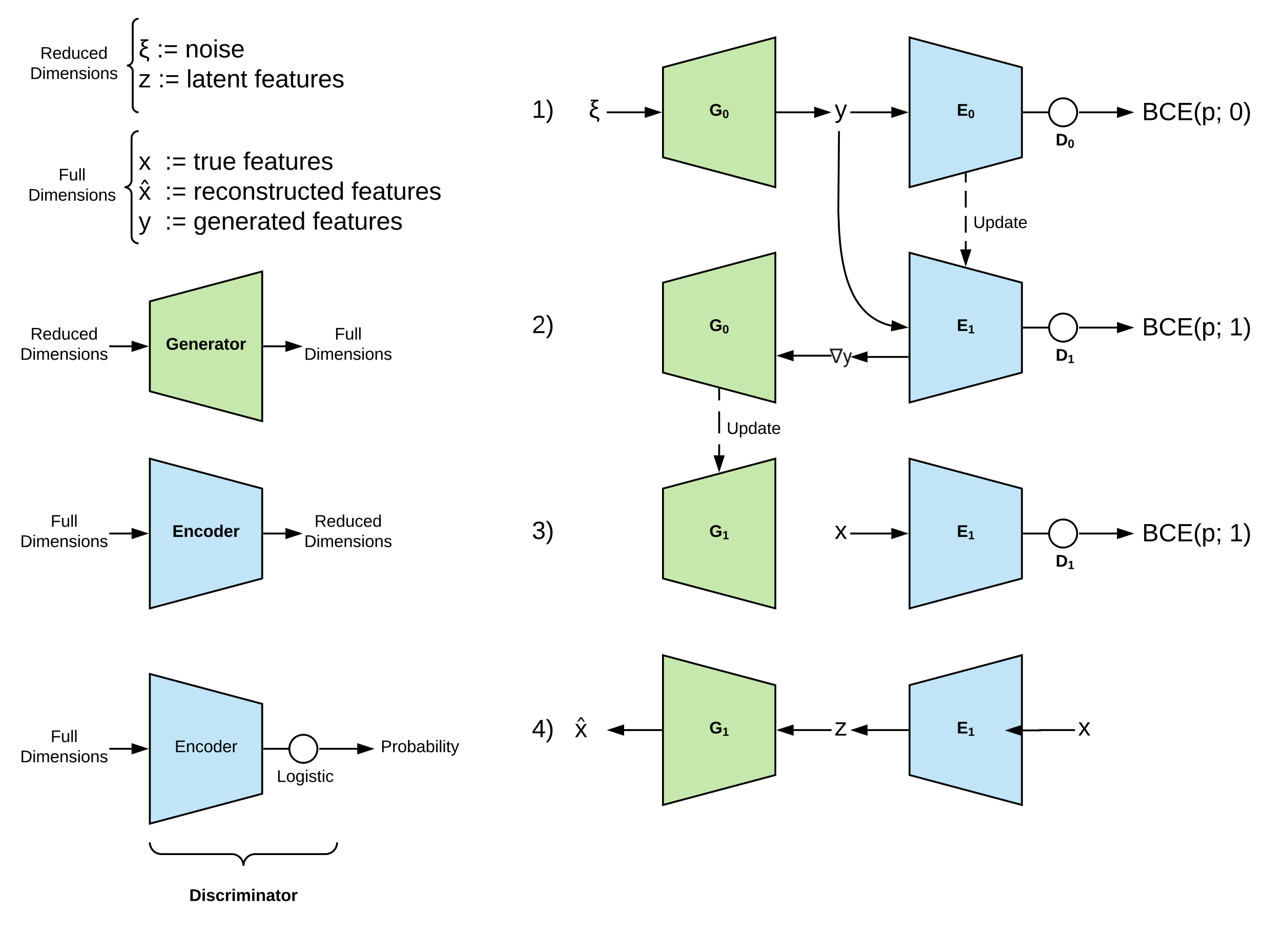
Generative
Adversarial
Networks
Notes:
Deep fakes and spoofing

Slide 16

Notes:
Bite sized

Slide 17
Hypothesis Generation vs Hypothesis Testing
Exploratory Data Analysis
Statistical analyses aimed to discover important relationships in order to suggest hypotheses to test.
[ Histograms | Box Plots | Correlation Matrices | Principal Components ]
Statistical Hypothesis Testing
Statistical inference based on the predicted outcomes resulting from hypothesis relative to some alternative hypotheses. (How confident are we the observed outcomes result from an actual relationship rather than just by coincidence?)
[ Sensitivity | Specificity | P-values ]
Notes:
Confirmation bias -

Slide 18
EDA slide
PCA interactive tool how it works

Slide 19
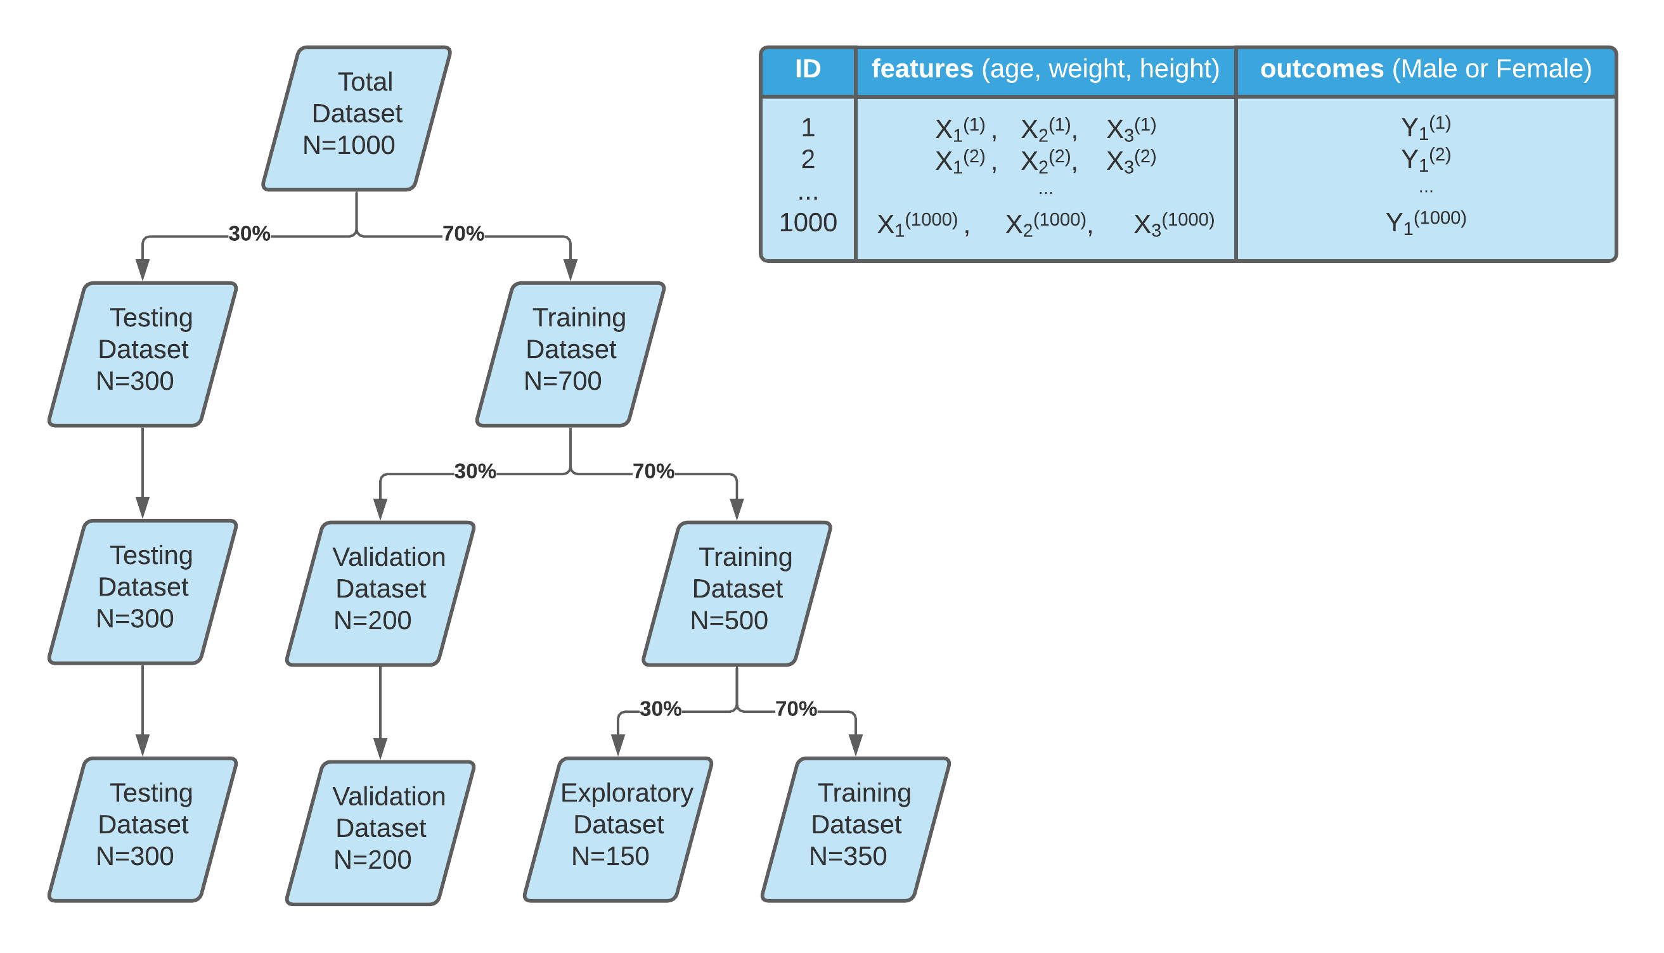

Slide 20
Getting to know your data
Lew M.J. (2019) A Reckless Guide to P-values. In: Bespalov A., Michel M., Steckler T. (eds) Good Research Practice in Non-Clinical Pharmacology and Biomedicine. Handbook of Experimental Pharmacology, vol 257. Springer, Cham. https://doi.org/10.1007/164_2019_286

Slide 21
On P-values
Culprits
Misunderstood
Misapplied
Answer questions no on asks
Unintentional p-hacking

Slide 22
Hypothesis test and Significance test
P < 0.05 is arbitray (but not unreasonable)
Neyman 1933: Type 1 erros (FP) and errors type 2 errors (FN) to formalize the concept of power.
More N = better Stats, More N = More $$$
Long deep history has crystalized p>0.05 dogma.
Frequentist approach can only reject the Null hypothesis.

Slide 23
Contradictory Instructions
Sometimes details of experiments cannot be reproduced 100%.
Judgments and debates on what is appropriate often driven by conviction rather than data.
P-value dogma -> conviction

Slide 24
P-values are not linear

Slide 25
Story telling and P-hacking

